Slide 1




DATATHON
Presented By :
Atsufumi Ozoe
Sivani Dronamraju
Swathi Baskaran
Sweta Dantu
Tania Lamprea Barragan
Thilak Mohan
William Moreno Mendez
Dataholics| 2024

Slide 2

2
TABLE OF CONTENTS
Data exploration
2. Analytical models
3. Expanding the League
4. Seattle vs Las Vegas
5. Sentiment analysis
6. Cost estimation
7. Operating expense
8. Revenue
9. Market composition
10. Sponsor
11. Mascot
12. Target segmentation
13. Brand Equity
14. International fanbase
Dataholics | 2024

Slide 3
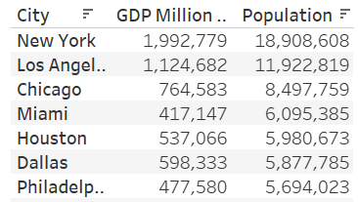
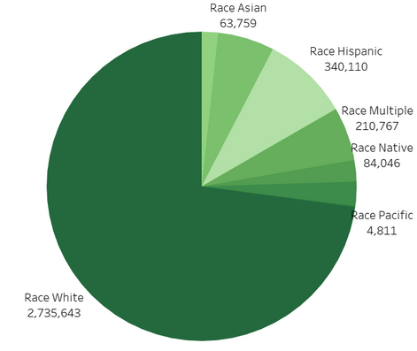
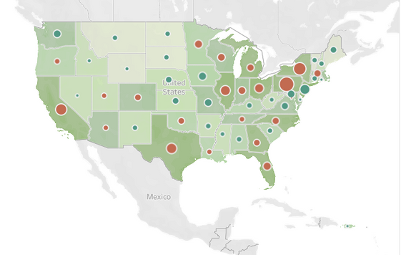
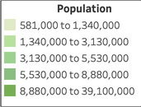
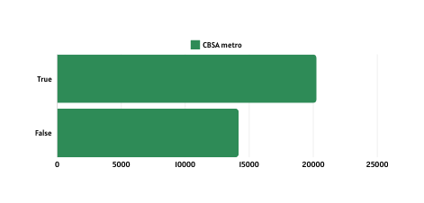
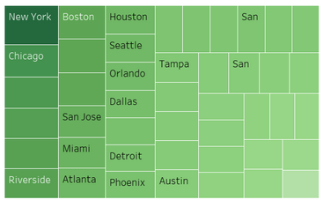
3
DATA EXPLORATION
- For NBA teams
Demographic features
Economic features
Race
Income median
Potential size of the fan base and market reach
Datahoilics | 2024
Broader pool of potential supporters and consumers
City with NBA team
Strong economic features indicate a robust market for ticket sales, and other revenue streams
City without an NBA team
CBSA metro
Geographic features
Provides insights into diversity and cultural dynamics of the population.
Commute time
Understanding racial and ethnic makeup helps tailor marketing strategies, engage communities, and foster inclusivity within the fan base.
Efficient transportation networks and metropolitan amenities enhance fan engagement and player recruitment, contributing to long-term success.

Slide 4
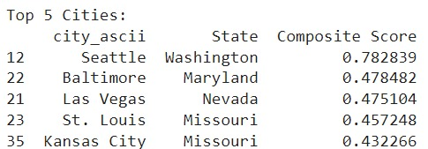
4
ANALYTICAL MODELS
Composite score
Assess each city's NBA readiness through a composite score
Normalized and weighted to highlight stronger metrics, ultimately identifying cities best suited for new teams
Score range: 0 to 1
Dataholics | 2024
Higher the score, higher the suitability of a city to host an NBA team
2. Outlier detection
Established NBA profiles through outlier detection.
Identify potential NBA host cities by comparing those without teams
Anomaly score, to pick the least anomalous city, alternatively, one that fits the normal behavior

Slide 5
5
EXPANDING THE LEAGUE
Seattle
We chose Seattle as our top pick due to its high composite score, alignment with characteristics of cities hosting NBA teams, rich basketball history with the Seattle Supersonics, and collective fan sentiment and nostalgia to revive the team.
What is different this time around?
The hurdles that forced Seattle's team to relocate, such as inadequate facilities and ownership changes, are now obsolete with the state-of-the-art Climate Pledge Arena and drastically increased funding opportunities fueled by the growth of tech industry.
Dataholics | 2024

Slide 6
6
2ND CITY ?
Las Vegas
Baltimore
Las Vegas was chosen for its unparalleled market opportunities, particularly in the thriving casino industry, offering lucrative sponsorships and innovative marketing avenues for the NBA team.
Baltimore's populous and high income median were outweighed by concerns about market saturation and potential competition from neighboring cities like Washington D.C., which could dilute local support and sponsorships.
Dataholics | 2024

Slide 7
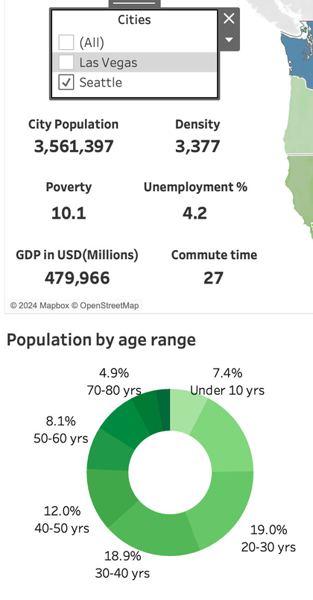
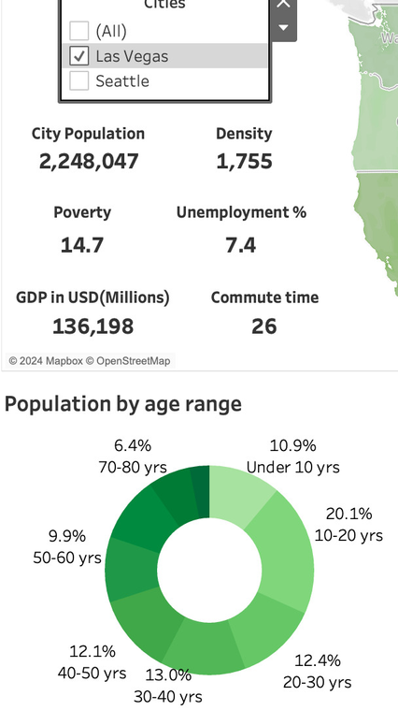

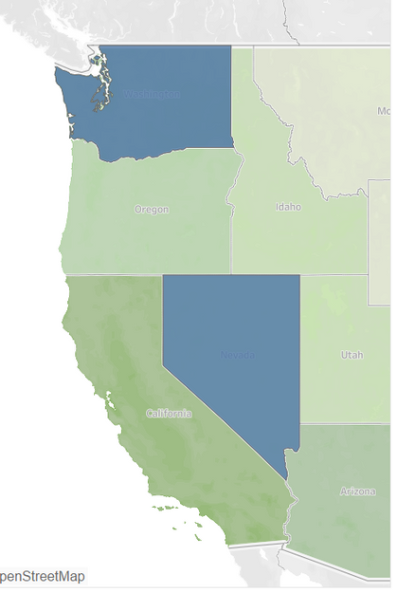
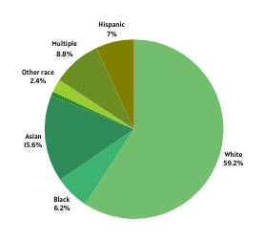
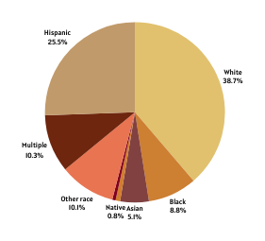
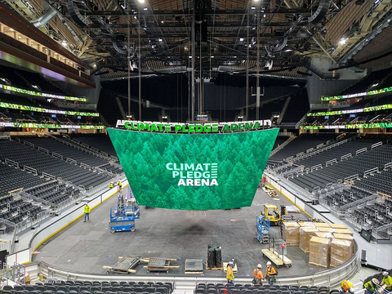
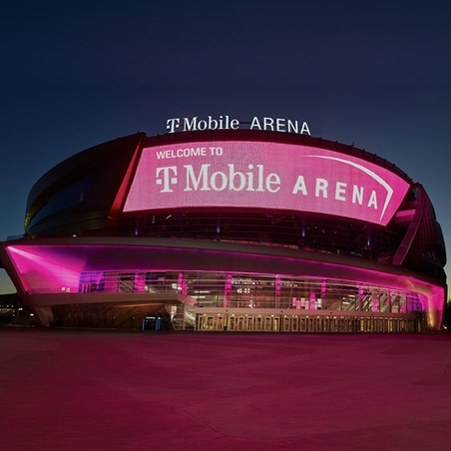
7
SEATTLE VS LAS VEGAS
Seattle
Datahoilics | 2024
Race
Race
Las Vegas
Climate pledge arena
T Mobile arena
$1.15 Billion
$375 Million

Slide 8
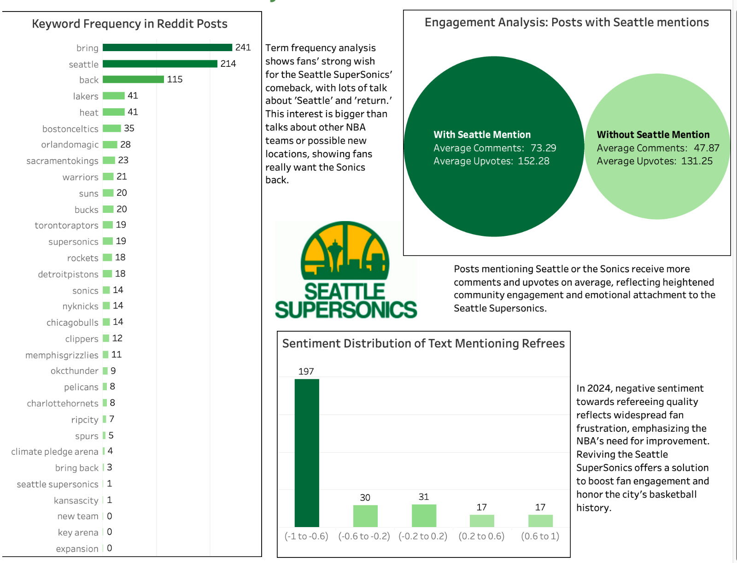

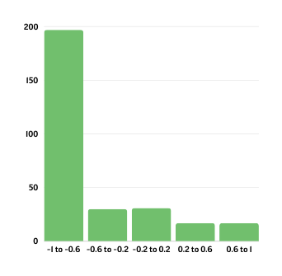
8
SENTIMENT ANALYSIS
Exploring NBA Fan Sentiment and Engagement: Insights from Reddit Posts
Keyword frequency in Reddit posts
Engagement analysis
Sentiment distribution of text mentioning referees
Term frequency analysis shows fans' strong wish for the Seattle SuperSonics' comeback, with lots of talk about 'Seattle' and 'return.'
Posts mentioning Seattle or the Sonics receive more comments and upvotes on average, reflecting heightened community engagement and emotional attachment to the Seattle Supersonics.
In 2024, negative sentiment towards refereeing quality reflects widespread fan frustration, emphasizing the NBA's need for improvement
Dataholics | 2024

Slide 9
9
COST ESTIMATION
Arena
Climate Pledge Arena
Arena revitalization at a cost of $1.15 billion.
Dataholics | 2024
Previously hosted the Seattle SuperSonics, an esteemed NBA team
Accommodates 18,300 basketball fans post renovation
Now serves as the venue for the NHL's Seattle Kraken, WNBA's Seattle Storm, and Seattle University Redhawks men's basketball.
Eliminates the need for construction expenses for a new team's arena.
The new NBA team does not need to raise capital to cover the upfront investment!

Slide 10
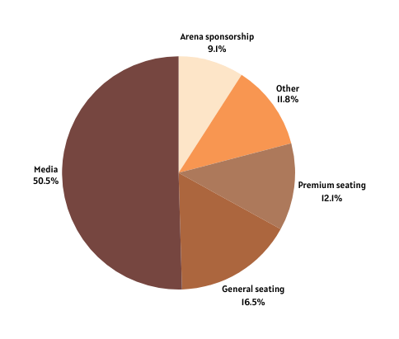
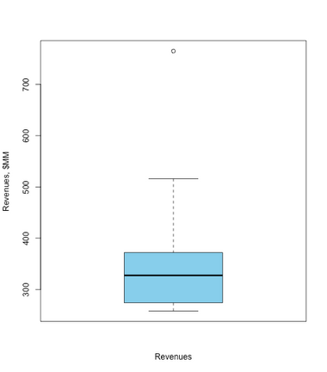
10
REVENUE
Sources:
Media: National broadcast rights and in-arena features generate revenue from showing the game.
Moneyball: NBA Revenue for 2022-23
General seating: Ticket sales from the majority of the arena seats bring in core game revenue.
Premium seating: Revenue from luxury boxes, club seats, and other high-end options offers a premium experience for a higher price
Dataholics | 2024
Arena sponsorship/advertisement: Companies pay to have their logos displayed in the arena, increasing brand awareness
Other: Concessions, parking, merchandise sales, and special events can add additional revenue streams
Estimated revenue generated from all the streams
Median Revenue of 30 NBA teams in 2022/2023 season = $320M
We assume the constant revenue of $320M each season
Source: Forbes reporting
Revenue

Slide 11
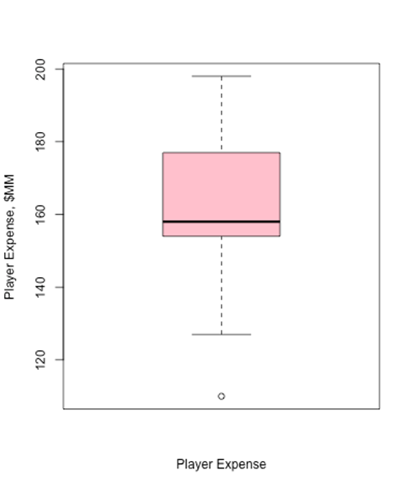
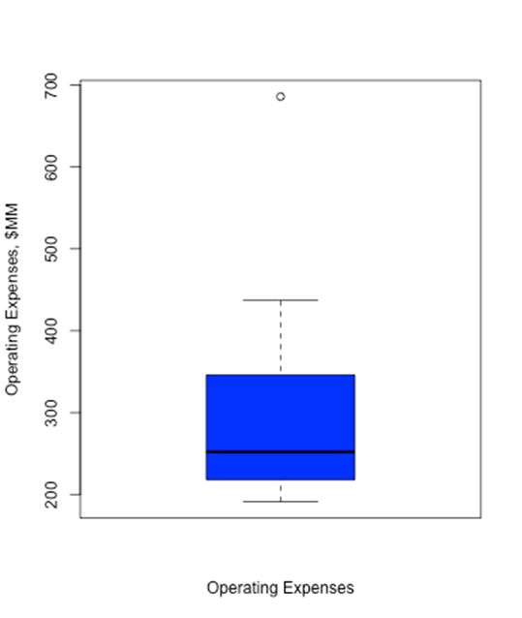
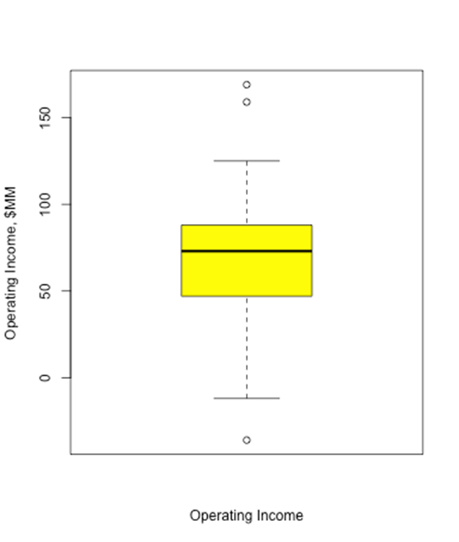
11
OPERATING EXPENSE
Player Expenses of each team
Operating Expenses of each team
Operating Incomes of each team
Dataholics | 2024
Operating cost =
Player salary $160M + Miscellaneous (20% of Revenue = $60M, including the arena leasing) = $220M
Operating income per year = Revenue ($320M) - Operating cost ($220M) = $100M per year
The new team would gain profits from 1st year because of no need for the new stadium construction
(= Break even is zero!)

Slide 12
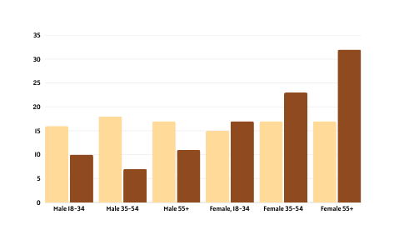
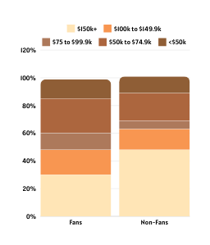
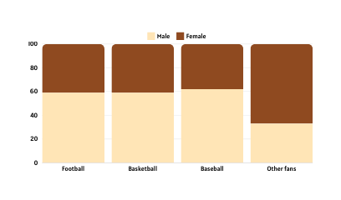
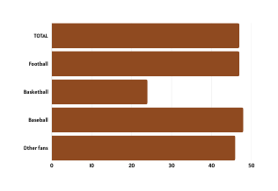
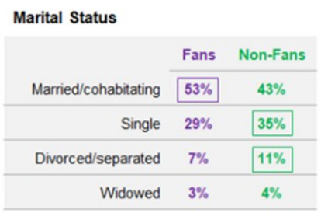
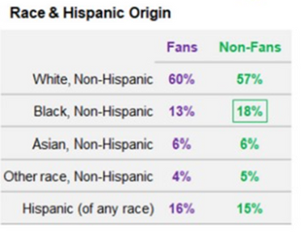
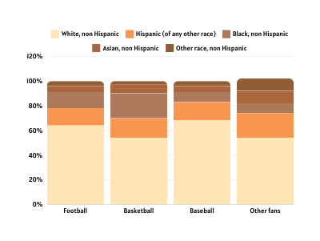
12
GLOBAL MARKET COMPOSITION
SPORTS FANS
NBA FANS
Household income
Gender
Gender & Age
The NBA fanbase predominantly comprises males.
Mean age
Sports fans primarily consist of younger males.
Sport Fans share is bigger among households with an income less than $100k
Among the three major sports in the US, NBA fans tend to be younger.
Marital status
Race and Hispanic origin
Race & Hispanic origin
Compared to the other big three sports, the NBA boasts a significant representation of Black and Hispanic fans.
The biggest portion of sport fans are married/cohabitating.
White and Hispanics have a higher representation in sport fans population
Source: Mintel, 2019
Dataholics | 2024

Slide 13
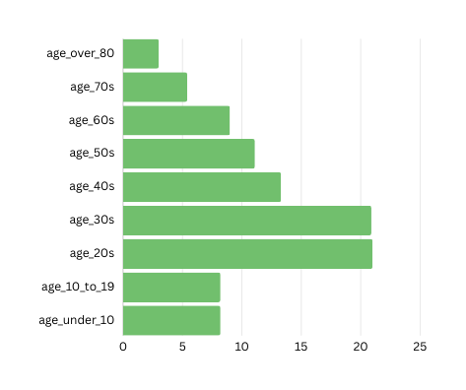
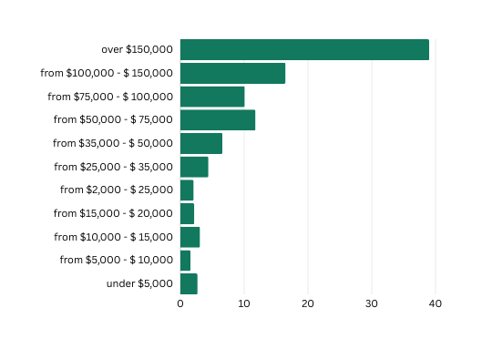
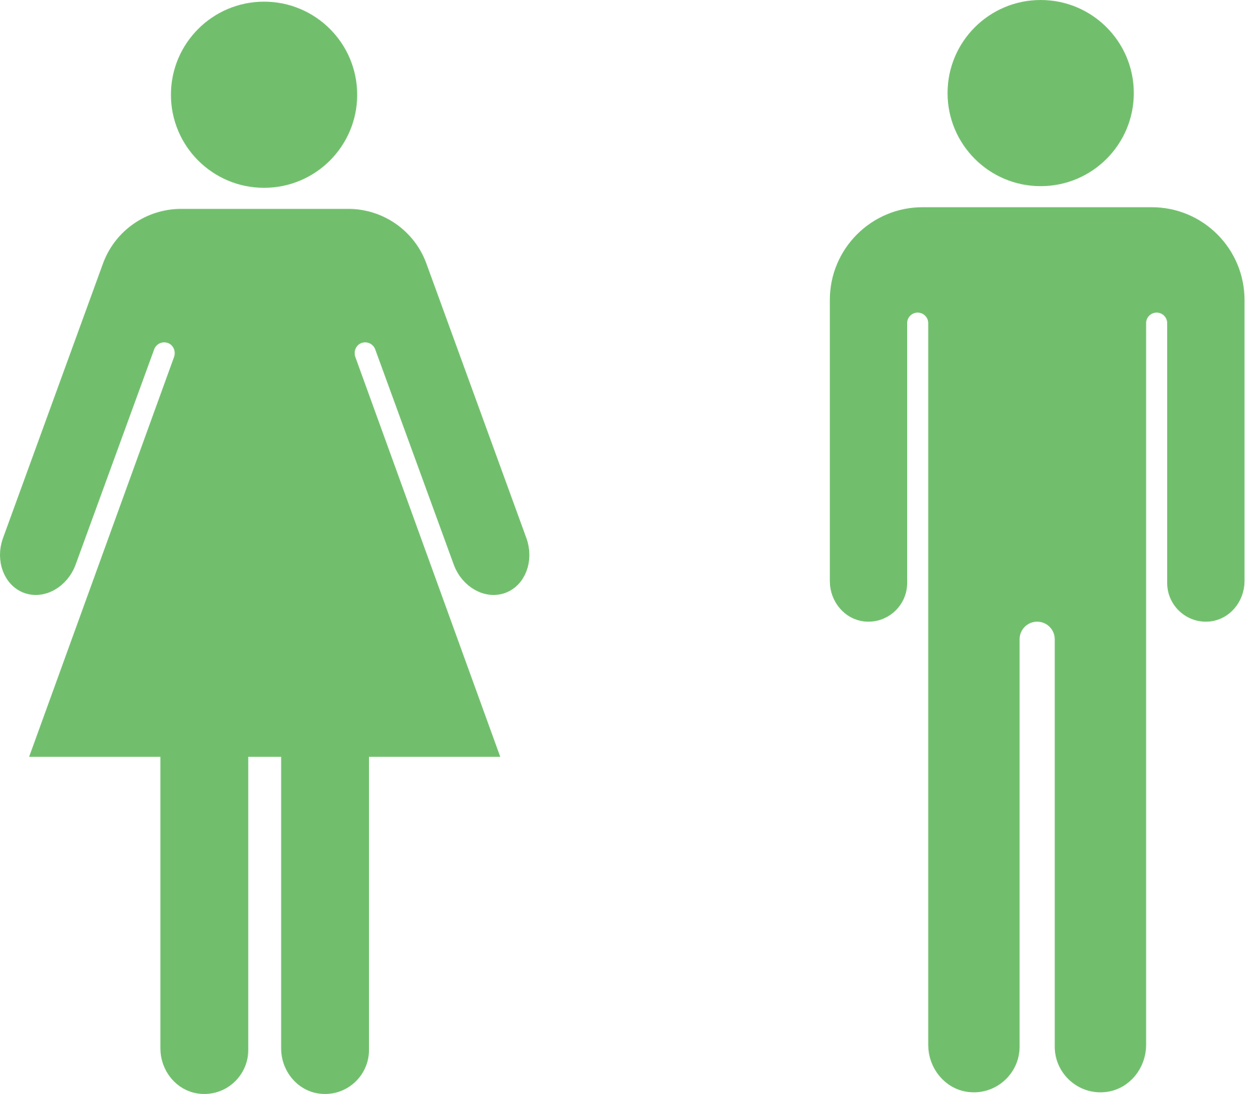
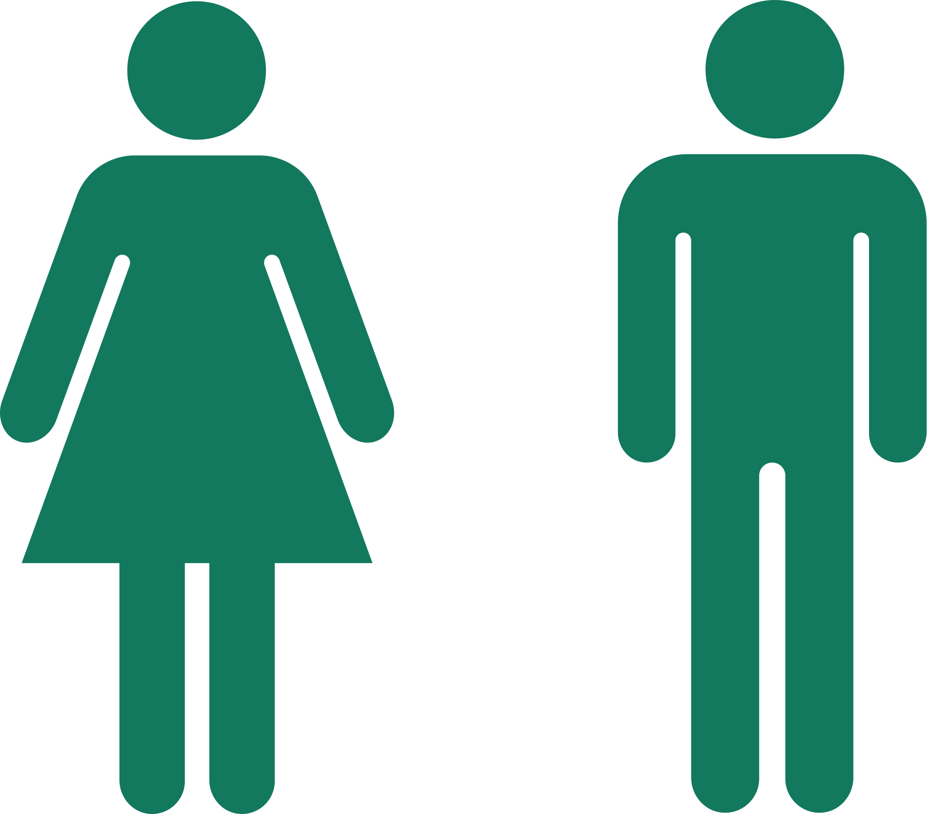
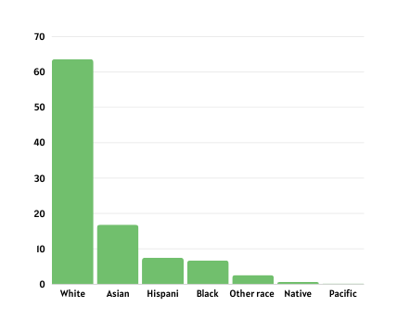

13
SEATTLE MARKET COMPOSITION
DEMOGRAPHICS
ECONOMICS
Population by gender
Population by age
Household income
48.9%
3
Median age: 35.4
39%
5.4
9
51.1%
11.1
The percentage of households with income over $150,000
13.3
The male population share is higher than the female one.
20.9
21
8.2
Population by ethnicity
8.2
66.6% of Seattle residents have at least 4 years degree.
56.7% of Seattle residents have a Bachelor’s degree in a science and Engineering field.
A little more than 50% of the population are between 20 and 40 years old.
Families
116,068
63,167
The family size of an average family in Seattle is 2,81 persons.
Median household
income.
The median income of
individual.
44.5%
40%
Of Seattle population are married
Percentage of households that own
(rather than rent) their residence.
Dataholics | 2024

Slide 14

14
SPONSOR
There are several potential common points between the new Seattle NBA team and Nordstrom that could be leveraged for a sponsorship partnership:
Local roots
Target market
Brand values
Marketing opportunities
Nordstrom is a longstanding Seattle institution, while the NBA team is poised to become a vital aspect of the city's identity and culture.
Nordstrom's target audience overlaps with NBA fans, making a sponsorship a good fit to strengthen their brand image locally.
Seattle's NBA team and Nordstrom could partner to leverage shared values and build positive brand image.
Seattle's NBA team and Nordstrom partnering could benefit both through co-branding, events, and leveraging their local connection.
Dataholics | 2024

Slide 15


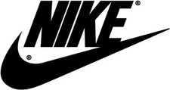
15
ALTERNATE SPONSORS
While Amazon's presence is significant in Seattle, we are seeking a brand that embodies the same heritage and ownership values as the Salmon mascot of our NBA team.
Microsoft is already engaged with the NBA on various fronts, such as using Microsoft Teams for virtual fan experiences and integrating Microsoft Azure into the NBA's data and analytics infrastructure.
Nike currently sponsors several NBA teams and serves as the official apparel provider for all NBA teams. To create a unique and fresh alliance, we aim to avoid aligning with a brand that is already heavily involved in sports sponsorships.
Dataholics | 2024

Slide 16

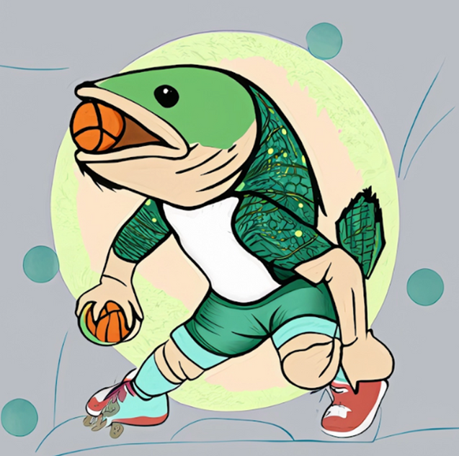

16
MASCOT
Skipper the Salmon
Symbolizes sustainability and nature.
Adopted by Seattle NFL, MLS, and WNBA teams.
Nostalgic connection to Supersonics team
Why
SALMON?
GREEN
Iconic and ecologically important species in the Pacific Northwest
Vital to the cultural heritage of Pacific Northwest indigenous peoples, serving as food, in ceremonies, and spiritually significant
EARTH TONES
colors
Brown and beige evoke nature and sustainability.
Sets team apart from others, like Boston Celtics
Dataholics | 2024

Slide 17









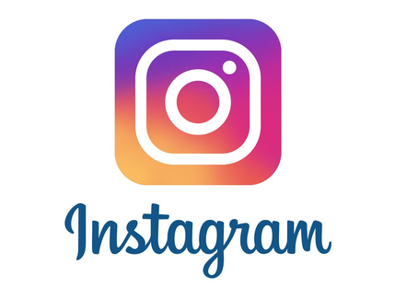
17
TARGET SEGMENT FOR NBA - SEATTLE
Name: Jordan Matthews
Age: From 20s to 30s, Adults Gen-Z
Level of education: Bachelor’s Degree or higher.
Family life: Compound or single families.
Household income: over $75,000
Demographics
and Economics
Dataholics | 2024
Engaging on Instagram-worthy experiences while attending stadium events.
Cultivating close relationships with athletes.
Enjoying quality family time together
Motivations
They gain
information by
You tube for accessing NBA older footage.
Blogs and websites to follow up recent updates and highlights of the games due to the long lasting season.
Social media

Slide 18
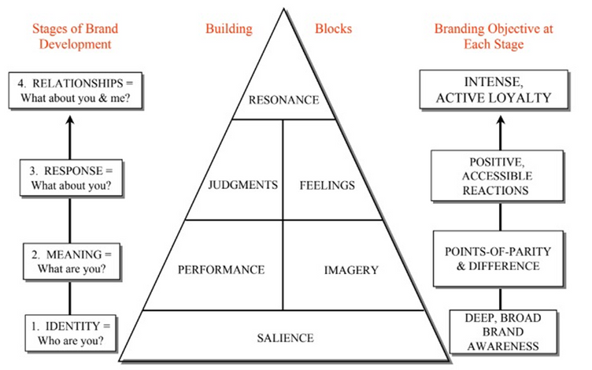
18
BUILDING BRAND EQUITY
Identity
Customer-based brand equity model pyramid.
Family Ticket Packages: Offer discounted packages for families, including tickets for adults and children, along with perks like food vouchers or merchandise discounts.
Dataholics | 2024
Family-Friendly Events: Host pre-game or post-game family events at the stadium, such as meet-and-greets with players, interactive games, or photo opportunities with team mascots.
NBA Junior Fantasy League: Develop a simplified fantasy basketball platform for children, with easy-to-understand scoring and player selection, plus educational content on basketball strategy, player stats, and teamwork.
Building strong brands in a modern marketing communications environment Kevin Lane Keller*

Slide 19
19
BUILDING BRAND EQUITY
Meaning and response
Customer-based brand equity model pyramid.
Educative information: Engaging videos explaining the rules and flow of the game, designed to inform and include both avid fans and newcomers without being patronizing or overwhelming
Highlight Exclusivity: Get excited about exclusive team merchandise with limited edition items and unique designs, making fans feel special.
Dataholics | 2024
Relationships
Social Media Campaigns: Youtube video series of the DIY (Do it Yourself) sponsor by the team athletes.
Open Communication Channels: Keep everyone informed by regularly sharing updates through social media, newsletters, and press releases.
Building strong brands in a modern marketing communications environment Kevin Lane Keller*

Slide 20

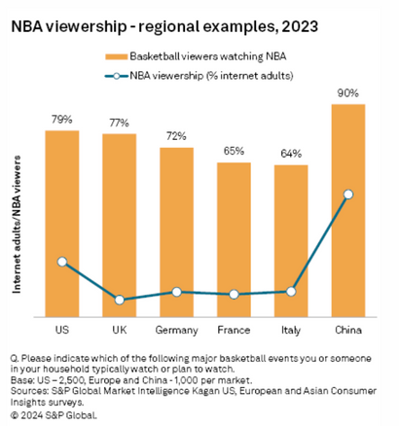
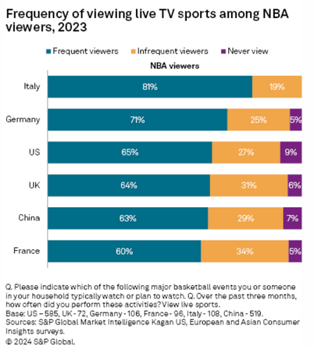
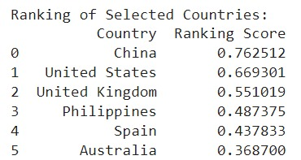
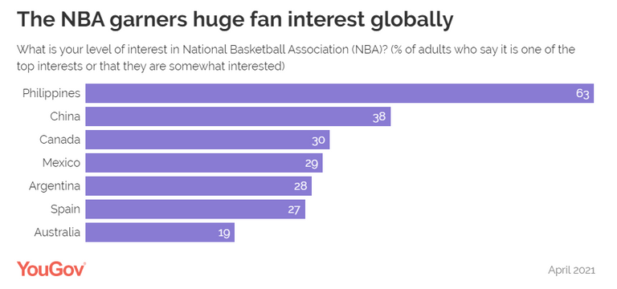
INTERNATIONAL FANBASE
20
CHINA
Dataholics | 2024
Identified six countries based on [1]
Key indicators from world_country_data dataset i.e. population density, GDP, urban population percentage, education enrollment rates, unemployment rate, and tax revenue percentage, were used to construct a comprehensive model.
Calculated a composite ranking score for each country by aggregating the weighted scores of the selected indicators.
This ranking score served as a quantitative measure of the countries attractiveness as potential markets for NBA expansion.
[1] source: S&P Global Market Intelligence
[2] source: YourGov

Slide 21
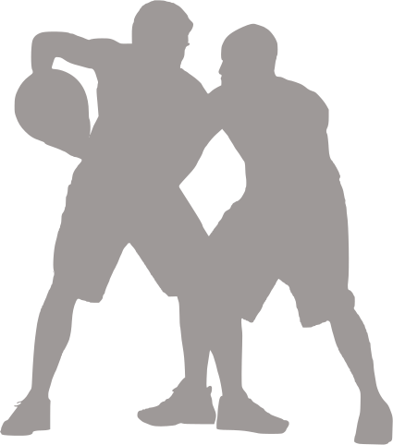
21
REFERENCES
Data sources
NBA Financial Data
US City Data
World Country Data
GDP per capita
Reddit API for sentiment analysis
Articles
Global market composition
Brand equity
International fanbase - YourGov
International fanbase - S&PGlobal
Dataholics | 2024

Slide 22


Dataholics | 2024
THANK YOU
With Seattle as our slam-dunk choice, we're ready to swim upstream to victory!

